Slide 1



TCGA Clustering Project
Middle Progress Report
Spyros Travlos

Slide 2

Contents
Company
Project Description
Dataset
Objectives
Clustering
Future Steps

Slide 3
Company
The project is carried out in collaboration with:
Intelligencia:
Helps bring novel therapies to patients faster and more efficiently by applying Data Science to drug development.

Slide 4
2) Project Description
The Cancer Genome Atlas (TCGA):
A landmark cancer genomics program
Molecularly characterized over 20,000 primary cancer and matched normal samples spanning 33 cancer types.(eg. Acute Myeloid Leukemia, Prostate Adenocarcinoma, Sarcoma)

Slide 5
2) Project Description
The Genotype-Tissue Expression (GTEx) project
An ongoing effort to build a comprehensive public resource to study tissue-specific gene expression and regulation
Samples were collected from 54 non-diseased tissue sites across nearly 1000 individuals

Slide 6
3) Dataset
60,499 identifiers (gene expressions) X 19039 samples
Source: University of California Santacruz
Dataset was created using xenaPython: API for connecting to xena hubs

Slide 7
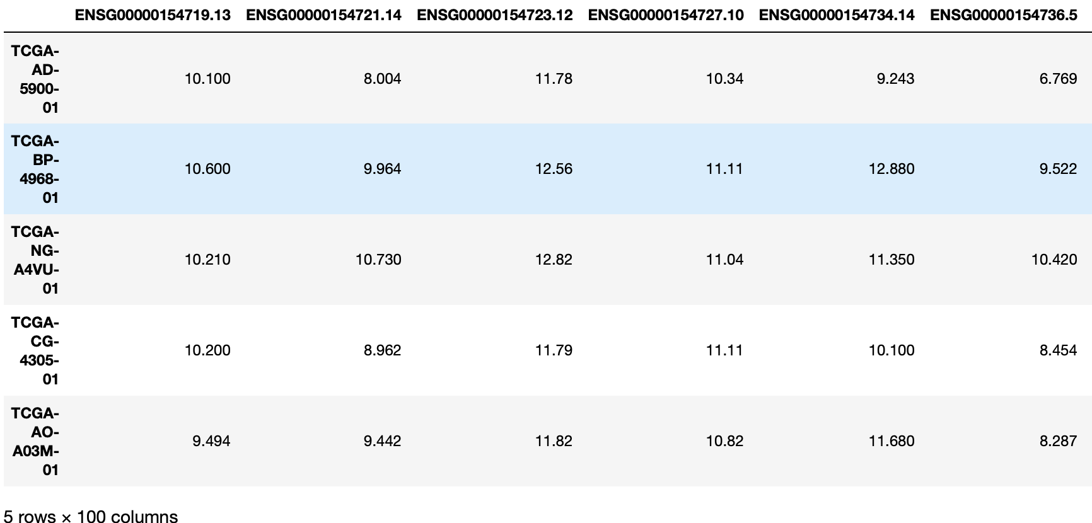
3) Dataset

Slide 8


3) Dataset
Normalized expression of the RNA-sequence of the gene found in the sample
Cancer sample

Slide 9

3) Dataset
Huge dataset (60,499 columns (gene expressions) X 19039 rows (samples) Needs some preprocessing.
Drop genes where:
small variation between samples (i.e. standard deviation less than 0.5)
2) or were 0 everywhere
3) Keep only protein coding genes - list from:

Slide 10
3) Dataset
The number of columns dropped from 60,499 to 19,039

Slide 11
4) Objectives
Perform Unsupervised Clustering on the TCGA samples to create groups of similar cancer samples
Compare with original category of sample
Develop an algorithm that predicts label of TCGA in test set
Perform Supervised Classification in GTEX and TCGA dataset to predict cancerous and healthy samples based on gene expression
Compare expressions of the GTEX and TCGA and extract useful conclusions

Slide 12
5) Clustering
In order to perform clustering we used three different Dimensionality reduction algorithms: PCA, t-SNE, umap
Their performance was judged based on how well the clusters are formed depending on the original detailed category of the sample

Slide 13
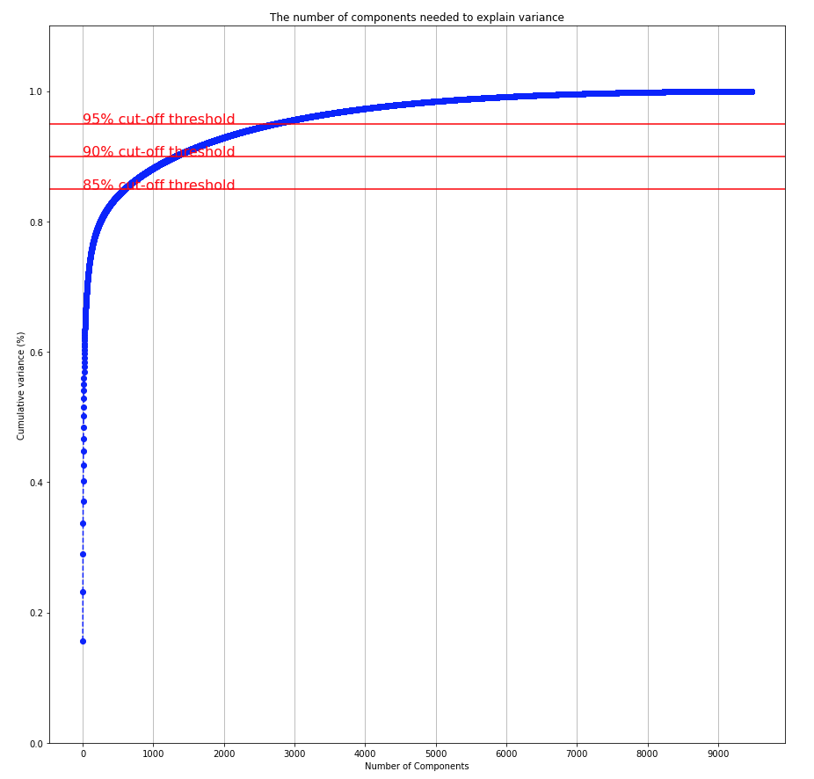
5) Clustering
For PCA we chose the number of feature to explain 85% of the variance i.e. 594 features

Slide 14
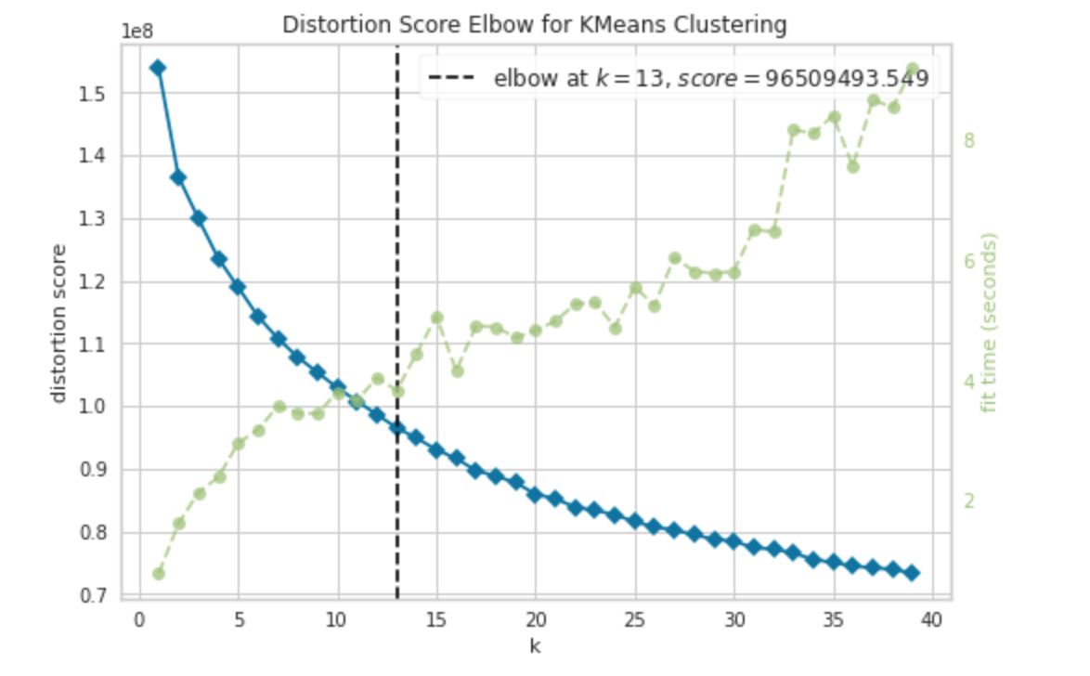
5) Clustering
1) PCA
Elbow method resulting in 13 clusters

Slide 15
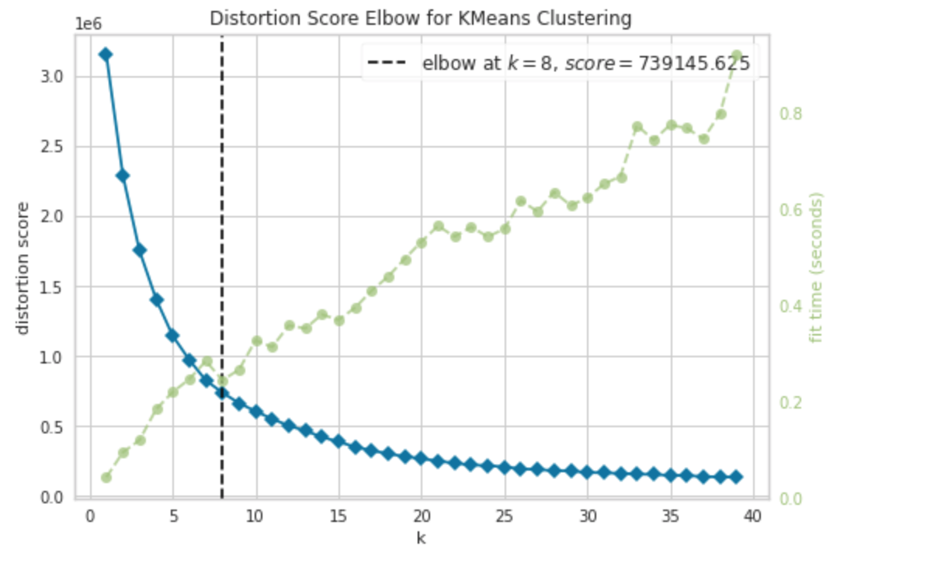
5) Clustering
2) t-SNE
Elbow method resulting in 8 clusters

Slide 16
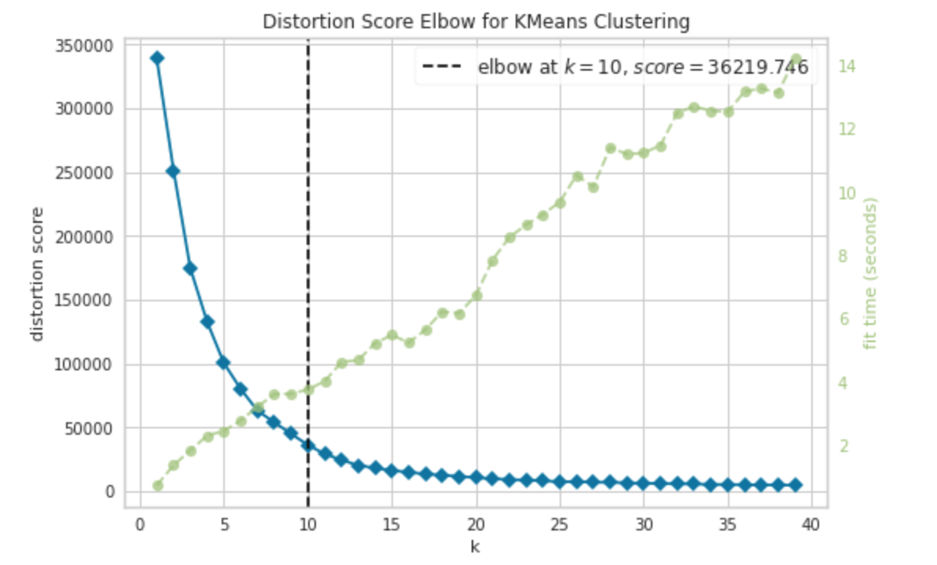
5) Clustering
2) Umap
Elbow method resulting in 10 clusters

Slide 17
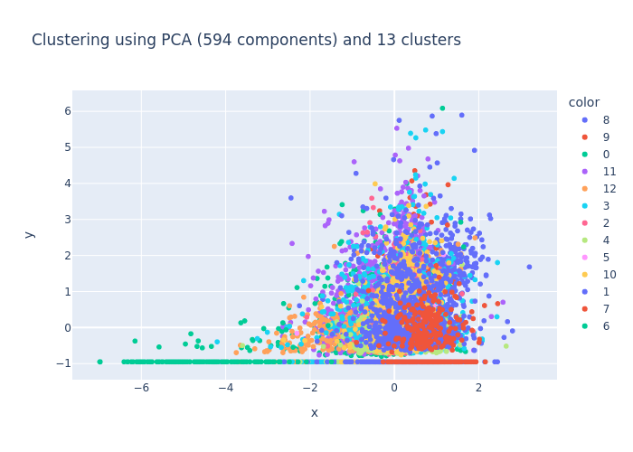
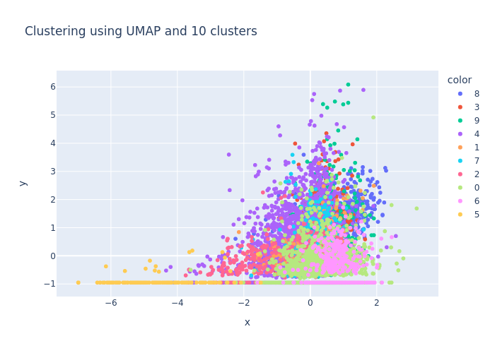
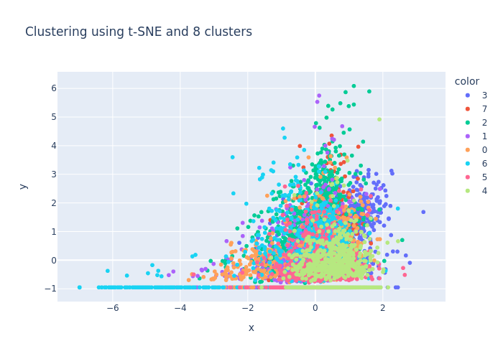

Slide 18
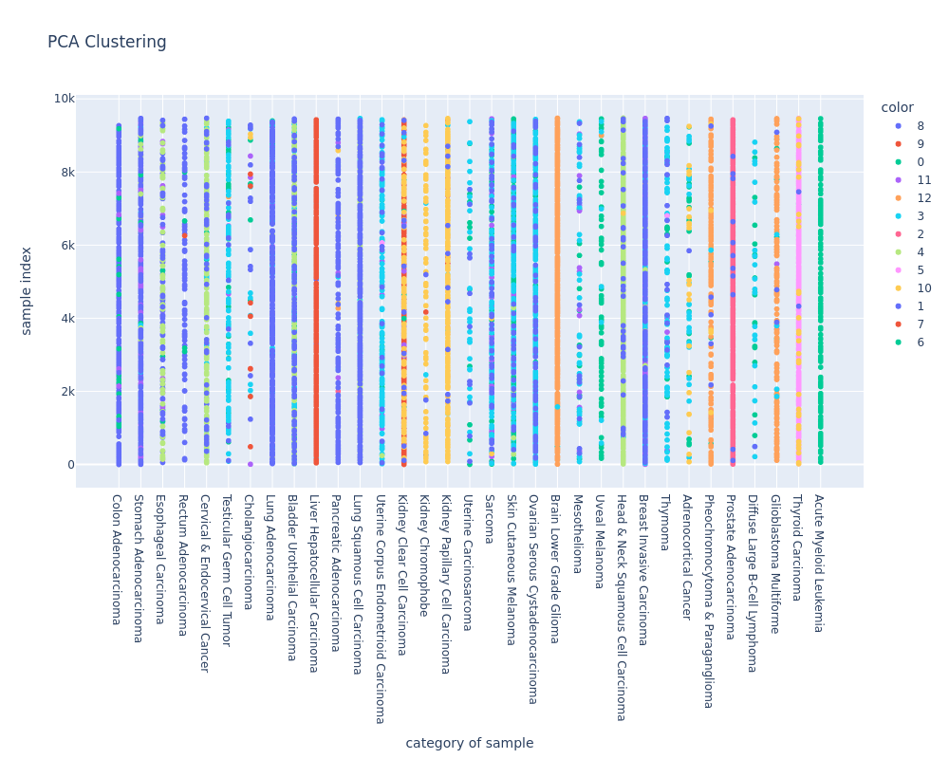

Slide 19
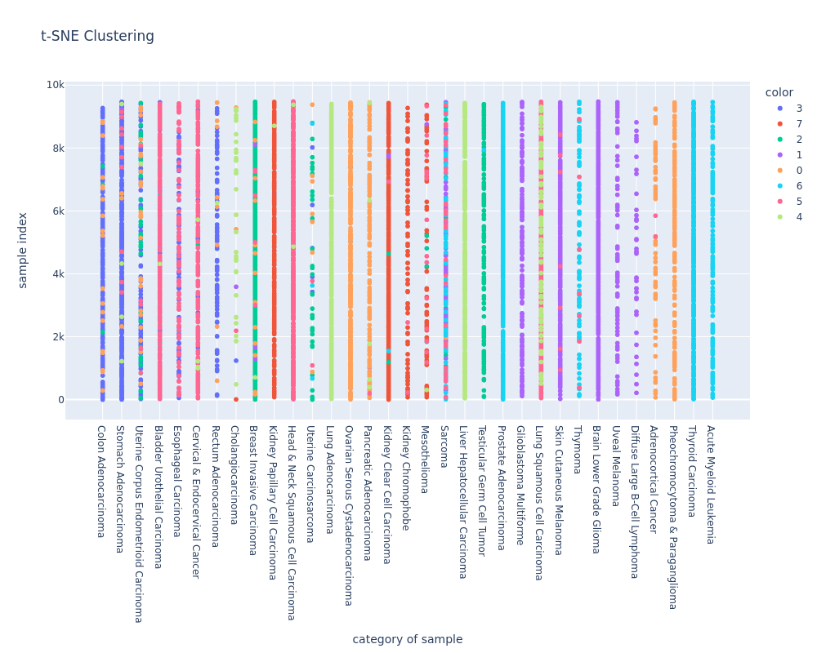

Slide 20
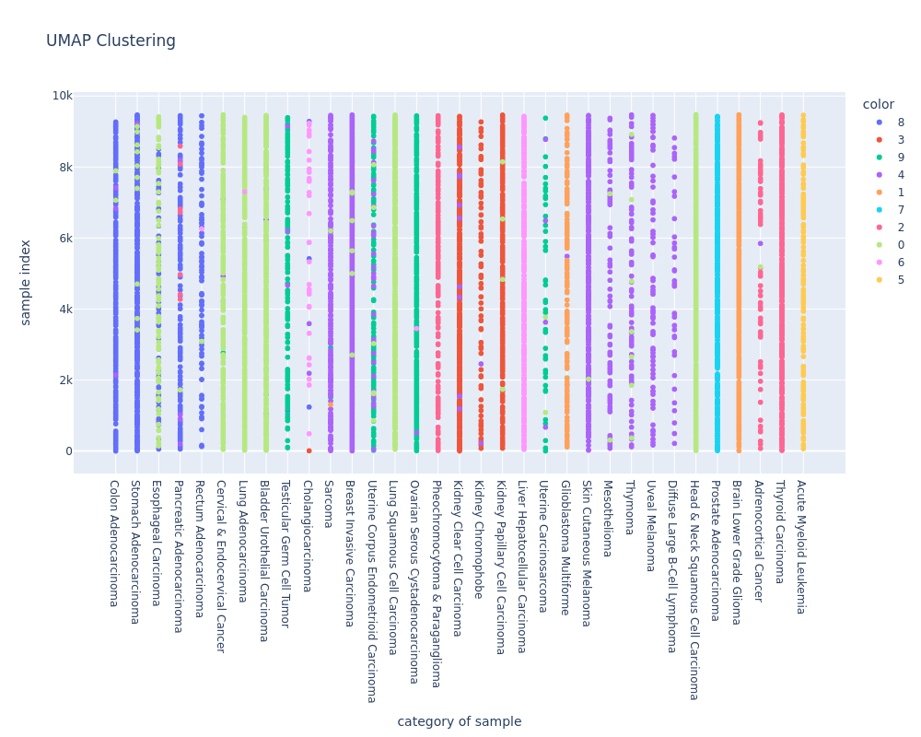

Slide 21
It seems that UMAP has done the best clustering as the detailed categories mostly fall under one particular cluster.
Here we will dive deeper into the categories according to the above graph:
Cluster 0: Esophageal Carcinoma, Cervical and Endocervical Cancer, Lung Adenocarcinoma, Bladder Urothelial Carcinoma, Lung Squamous cell Carcinoma, Head and Neck Squamous cell Carcinoma - These affect mostly the respiratory system. Also it contains cancers in the bladder and uterus. Quite an unclear cluster
Cluster 1: Brain lower grade glioma, Glioblastoma Multiforme - These have to do with the brain
Cluster 2: Pheochromocytoma and Parangaglioma, Adrenocortical cancer, Thyroid carcinoma - These affect glands, the first two types affect the adrenal gland whereas the third affects the thyroid gland (adrenocortinal system)
Cluster 3: Kidney Clear Cell Carcinoma, Kidney Chromophobe, Kidney Papillary Cell Carcinoma - These are on kidneys

Slide 22
Cluster 4: Sarcoma, Breast Invavise carcinoma, Skin cutaneous melanoma, Mesothelioma, Thymoma, Uveal Melanoma, Diffuse Large Cell B-Cell Lymphoma - Occur mainly in tissues
Cluster 5: Acute Myeloid Leukemia – Leukemia
Cluster 6: Cholangiocarcinoma, Liver Hepatocellular Carcinoma - Cholangiocarcinoma occurs in the bile which resides in the liver
Cluster 7: Prostate Adenocarcinoma - Prostate
Cluster 8: Colon Adenocarcinoma, Stomach adenocarcinoma, Pancreatic adenocarcinoma, Rectum Adenocarcinoma - These are cancers that affect the digestive and excretory system
Cluster 9: Testicular Germ Cell Tumor, Uterine corpus endometrioid carcinoma, Ovarian Cerous Cystadenocarcinoma - These affect organs of the reproductive system

Slide 23
6) Future Steps
The project will continue with the rest of the objectives starting from predicting the label of the samples in the test set

Slide 24
QUESTIONS ?

